Slide 1
Chapter9
I2C Protocol and RTC Interfacing

Slide 2
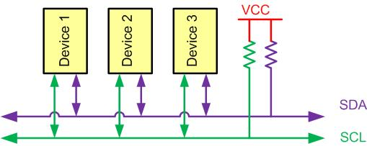
I2C Bus Characteristics

Slide 3
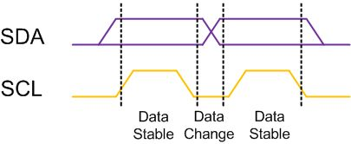
I2C Bit Format

Slide 4
START and STOP Conditions

Slide 5
REPEATED START Condition

Slide 6
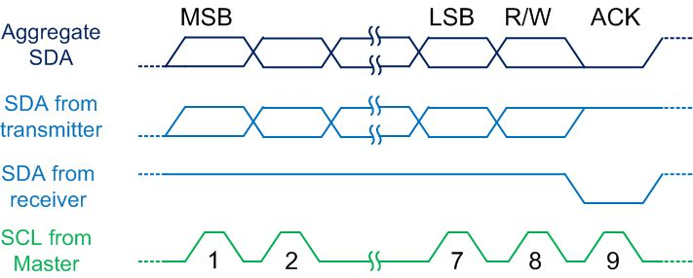
Byte Format in I2C

Slide 7
Address Byte Format in I2C

Slide 8
Typical Data Transmission

Slide 9
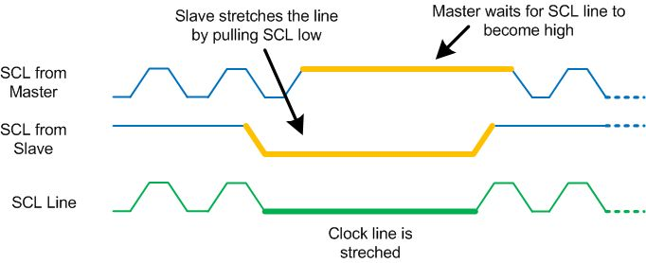
Clock Stretching

Slide 10
Multi-byte Burst Write

Slide 11
Multi-byte Burst Read

Slide 12
I2C Module Base Address for TI Tiva
SSI Module | Base Address
I2C 0 | 0x4002.0000
I2C 1 | 0x4002.1000
I2C 2 | 0x4002.2000
I2C 3 | 0x4002.3000

Slide 13
RCGCI2C, Offset 0x620

Slide 14
RCGCI2C Description
Bits | Name | Function | Description
0 | R0 | I2C 0 Run Mode Clock Gating Control | 1 to enable and 0 to disable
1 | R1 | I2C 1 Run Mode Clock Gating Control | 1 to enable and 0 to disable
2 | R2 | I2C 2 Run Mode Clock Gating Control | 1 to enable and 0 to disable
3 | R3 | I2C 3 Run Mode Clock Gating Control | 1 to enable and 0 to disable

Slide 15
I2CMTPR, Offset 0x0C

Slide 16
I2CMCR, Offset 0x020

Slide 17
I2CMCR Description
Bits | Name | Function | Description
0 | LPBK | I2C Loopback | 0: Normal operation, 1: Loopback
4 | MFE | I2C Master Function Enable | 1: Enable Master Function, 0: Disable
5 | SFE | I2C Slave Function Enable | 1: Enable Slave Function, 0: Disable
6 | GFE | I2C Glitch Filter Enable | 1: Enable Glitch Filter, 0: Disable

Slide 18
I2CMSA, Offset 0x000

Slide 19
I2CMDR, Offset 0x008

Slide 20
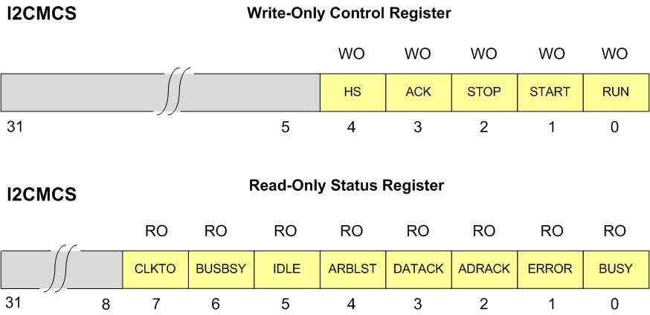
I2CMCS, Offset 0x004

Slide 21
I2CMS Write-Only Register
Bits | Name | Function | Description
0 | RUN | I2C Master Enable | 1: Master is enable to transfer data
1 | START | Generate START | It should be 1 to generate Start condition
2 | STOP | Generate STOP | It should be 1 to generate Stop condition
3 | ACK | Data Acknowledge Enable | It should be 1 to generate auto ACK
4 | HS | High-Speed Enable | It should be 1 to run in high speed mode

Slide 22
I2CMS Read-Only Register
Bits | Name | Function | Description
0 | BUSY | I2C Busy | 0: The controller is idle
1 | ERROR | Error | 0: No error was detected
2 | ADRACK | Acknowledge Address | 0: The transmitted address was acknowledged
3 | DATACK | Acknowledge Data | 0: The transmitted data was acknowledged
4 | ARBLST | Arbitration Lost | 0: The I2C controller won arbitration
5 | IDLE | I2C Idle | 0: The I2C controller is not idle
6 | BUSBSY | Bus Busy | 0: The I2C bus is idle
7 | CLKTO | Clock Timeout Error | 0: No clock timeout error

Slide 23
I2C Pin Assignment
SSI Module Pin | GPIO Pin | SSI Module Pin | GPIO Pin
I2C0SCL | PB2 | I2C2SCL | PB4
I2C0SDA | PB3 | I2C2SDA | PB5
I2C1SCL | PA6 | I2C3SCL | PD0
I2C1SDA | PA7 | I2C3SDA | PD1

Slide 24
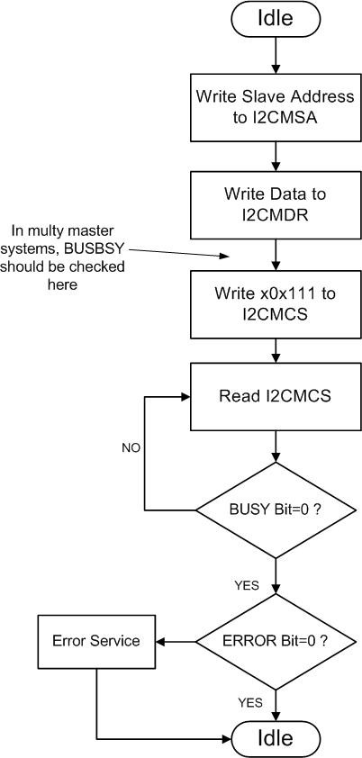
Master Single Transmit

Slide 25
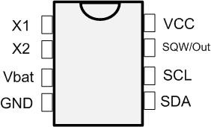
DS1307 Pins

Slide 26
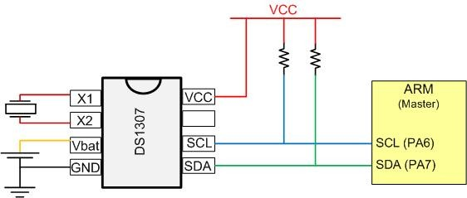
DS1307 Connections

Slide 27
DS1307 Address Map
Address | Bit7 |  | Bit6 | Bit5 | Bit4 | Bit3 | Bit2 | Bit1 | Bit0 |  | Function | Range
00H | CH |  | 10 Seconds |  |  | Seconds |  |  |  |  | Seconds
01H | 0 |  | 10 Minutes |  |  | Minutes |  |  |  |  | Minutes
02H | 0 |  | 12 24 | 10hour PM/AM | 10hour | Hours |  |  |  |  | Hours | 1-12 0-23
03H | 0 |  | 0 | 0 | 0 | 0 | Day |  |  |  | Day | 0-7
04H | 0 |  | 0 | 10 Date |  | Date |  |  |  |  | Date | 01-31
05H | 0 |  | 0 | 0 | 10Mnt | Month |  |  |  |  | Month | 1-12
06H | 10 Year |  |  |  |  | Year |  |  |  |  | Year | 00-99
07H | out | 0 |  | 0 | SQWE | 0 | 0 | RS1 |  | RS0 | Control | -
08H-3FH |  |  |  |  |  |  |  |  |  |  | RAM 56x8 | 0-FFH

Slide 28
RS bits
RS1 | RS0 | Output Frequency
0 | 0 | 1 Hz
0 | 1 | 4.096 kHz
1 | 0 | 8.192 kHz
1 | 1 | 32.768 kHz

