Slide 1
Chapter 7
ADC, DAC, and Sensor Interfacing

Slide 2
Microcontroller Connection to Sensor via ADC

Slide 3
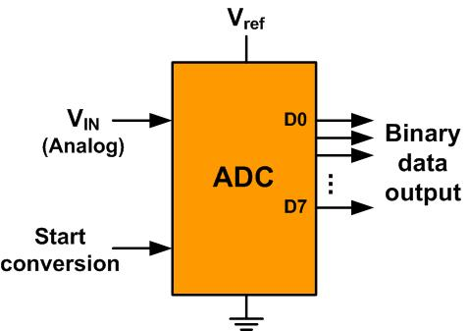
An 8-bit ADC Block Diagram

Slide 4
Resolution versus Step Size for ADC (Vref = 5V)
n-bit | Number of steps | Step size
8 | 256 | 5V /256 = 19.53 mV
10 | 1024 | 5V /1024 = 4.88 mV
12 | 4096 | 5V /4096 = 1.2 mV
16 | 65,536 | 5V /65,536 = 0.076 mV
Note: V_{ref} = 5V

Slide 5
Vref Relation to Vin Range for an 8-bit ADC
V_{ref} (V) | V_{in} in Range (V) | Step Size (mV)
5.00 | 0 to 5 | 5 / 256 = 19.53
4.00 | 0 to 4 | 4 / 256 = 15.62
3.00 | 0 to 3 | 3 / 256 = 11.71
2.56 | 0 to 2.56 | 2.56 / 256 = 10
2.00 | 0 to 2 | 2 / 256 = 7.81
1.28 | 0 to 1.28 | 1.28 / 256 = 5
1.00 | 0 to 1 | 1 / 256 = 3.90
Note: In an 8-bit ADC, step size is V_{ref}/256

Slide 6
Vref Relation to Vin Range for an 10-bit ADC
Vref (V) | V_{in}Range (V) | Step Size (mV)
5.00 | 0 to 5 | 5 / 1024 = 4.88
4.96 | 0 to 4.096 | 4.096 / 1024 = 4
3.00 | 0 to 3 | 3 / 1024 = 2.93
2.56 | 0 to 2.56 | 2.56 / 1024 = 2.5
2.00 | 0 to 2 | 2 / 1024 = 2
1.28 | 0 to 1.28 | 1.28 / 1024 = 1.25
1.024 | 0 to 1.024 | 1.024 / 1024 = 1
Note: In a 10-bit ADC, step size is V_{ref}/1024

Slide 7
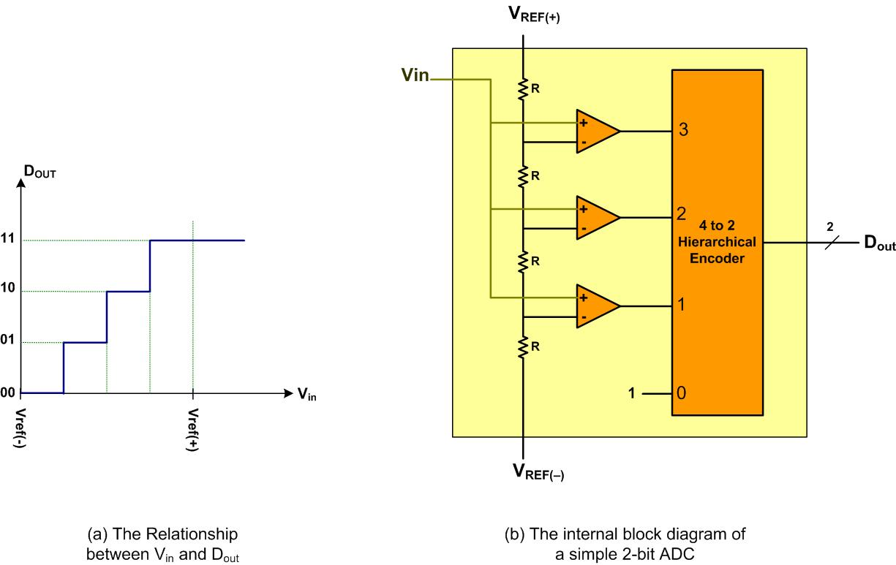
A Simultaneous 2-bit ADC

Slide 8
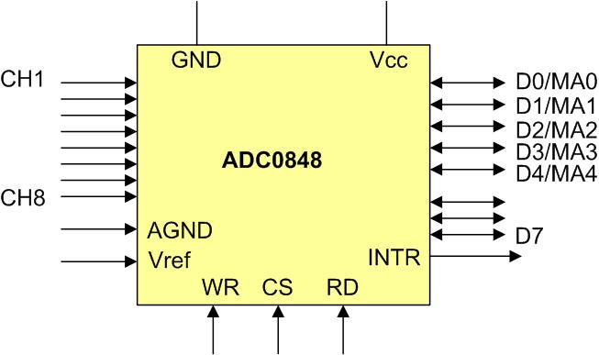
ADC0848 Parallel ADC Block Diagram

Slide 9
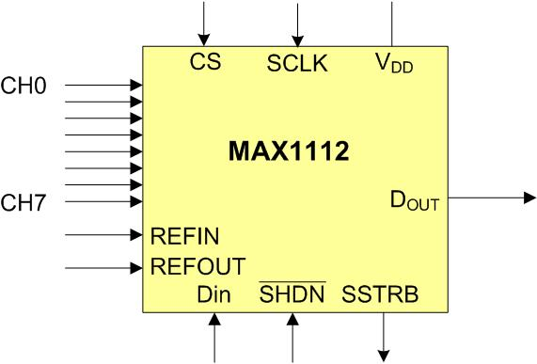
MAX1112 Serial ADC Block Diagram

Slide 10
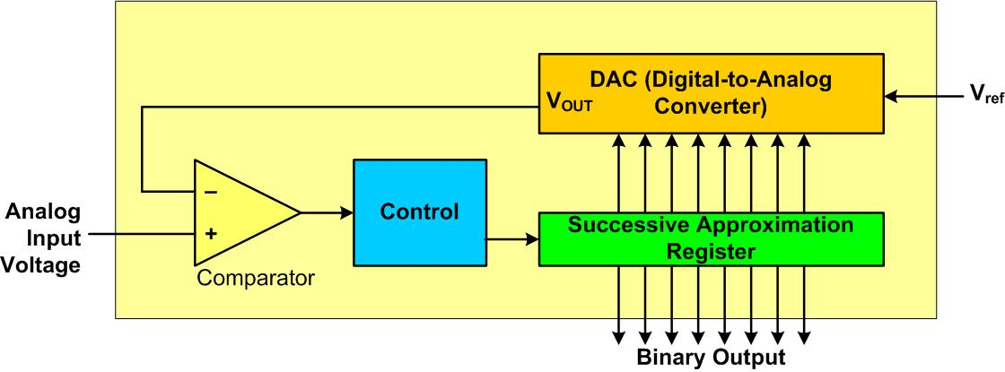
Successive Approximation ADC

Slide 11
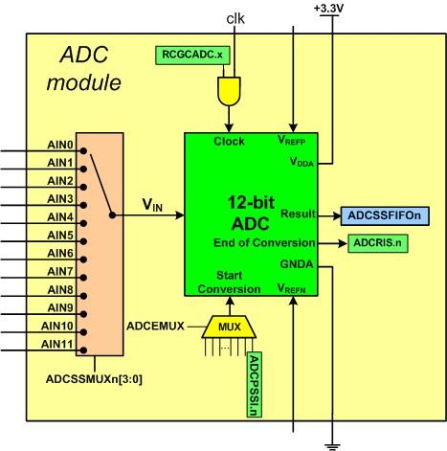
Simplified Block Diagram of a TI ADC Module

Slide 12
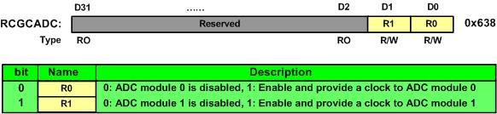
ADC Run Mode Clock Gating Control (RCGCADC)

Slide 13
Samples and FIFO Depth of Sequencers
Sequencer | Number of Samples | Depth of FIFO
SS0 | 8 | 8
SS1 | 4 | 4
SS2 | 4 | 4
SS3 | 1 | 1

Slide 14
ADC Active Sample Sequencer (ADCACTSS)

Slide 15
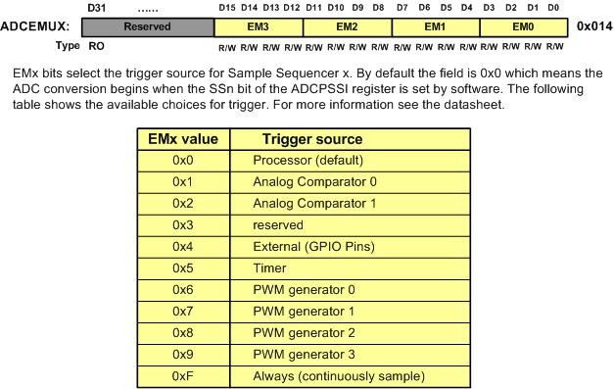
ADC Event Multiplexer Select (ADCEMUX)

Slide 16
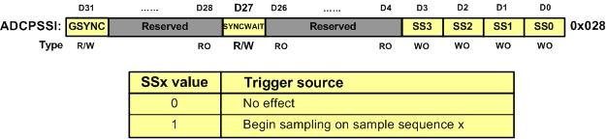
ADC Processor Sample Sequence Initiate (ADCPSSI)

Slide 17
Analog input pin assignment in TI Tiva TMC123GH6PM
Pin Name | Description | Pin | Pin Number
AIN0 | ADC input 0 | PE3 | 6
AIN1 | ADC input 1 | PE2 | 7
AIN2 | ADC input 2 | PE1 | 8
AIN3 | ADC input 3 | PE0 | 9
AIN4 | ADC input 4 | PD3 | 64
AIN5 | ADC input 5 | PD2 | 63
AIN6 | ADC input 6 | PD1 | 62
AIN7 | ADC input 7 | PD0 | 61
AIN8 | ADC input 8 | PE5 | 60
AIN9 | ADC input 9 | PE4 | 59
AIN10 | ADC input 10 | PB4 | 58
AIN11 | ADC input 11 | PB5 | 57

Slide 18
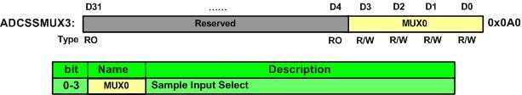
ADC Sample Sequence Input Multiplexer Select 3 (ADCSSMUX3)

Slide 19
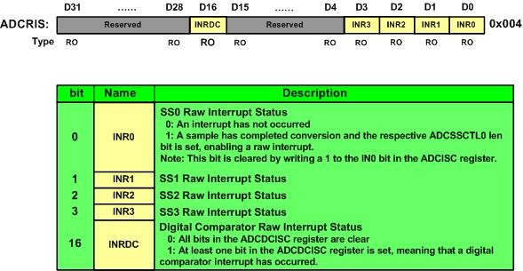
ADC Raw Interrupt Status (ADCRIS)

Slide 20
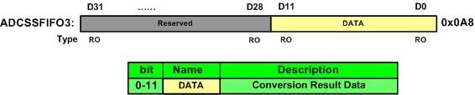
ADC Sample Sequence Result FIFO 3 (ADCSSFIFO3)

Slide 21
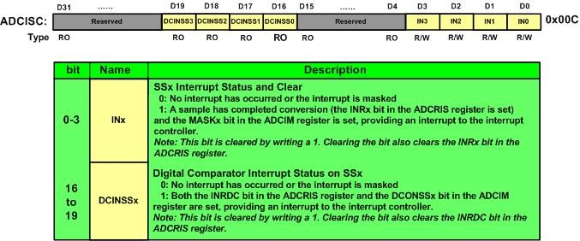
ADC Interrupt Status and Clear (ADCISC)

Slide 22
ADC channel pairing for differential
Differential Pair | Analog Inputs
0 | 0 and 1
1 | 2 and 3
2 | 4 and 5
3 | 6 and 7
4 | 8 and 9
5 | 10 and 11

Slide 23
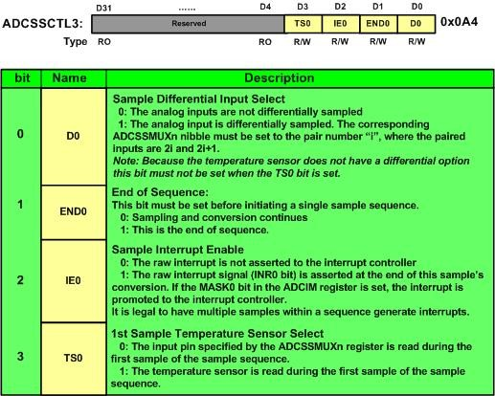
ADC Sample Sequence Control 3 (ADCSSCTL3)

Slide 24
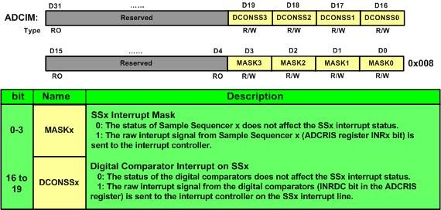
ADC Interrupt Mask (ADCIM)

Slide 25
ADC channel pairing for differential
ADC Channel | Pin
AIN0 | PE3
AIN1 | PE2
AIN2 | PE1
AIN3 | PE0
AIN4 | PD3
AIN5 | PD2
AIN6 | PD1
AIN7 | PD0
AIN8 | PE5
AIN9 | PE4
AIN10 | PB4
AIN11 | PB5

Slide 26
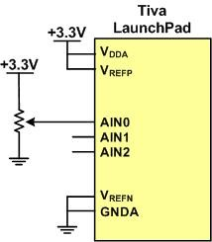
ADC Connection for Program 7-1

Slide 27
Thermistor Resistance vs. Temperature
Temperature ('C) | Tf (K ohms)
0 | 29.490
25 | 10.000
50 | 3.893
75 | 1.700
100 | 0.817

Slide 28
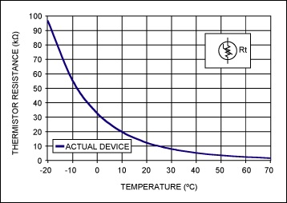
Thermistor
(Copied from http://www.maximintegrated.com)

Slide 29
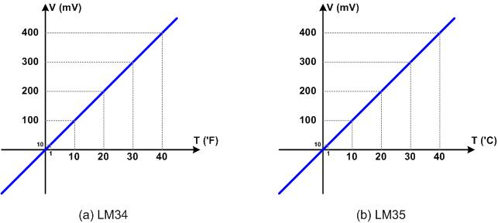
LM34 and LM35

Slide 30
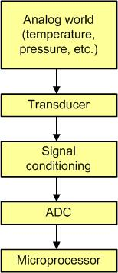
Getting Data to the CPU

Slide 31
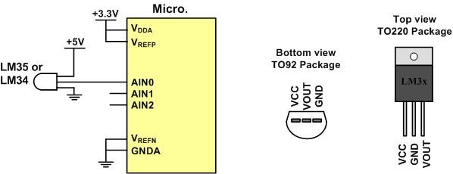
LM34/35 Connection to ARM and Its Pin Configuration

Slide 32
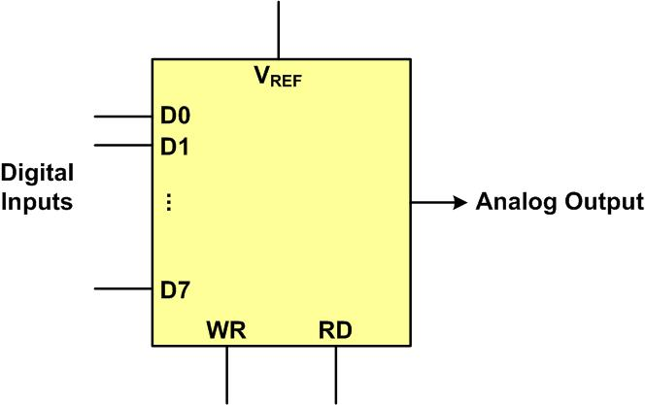
DAC Block Diagram

Slide 33
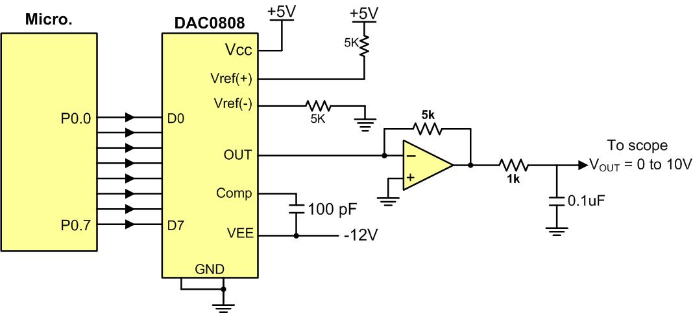
Microcontroller Connection to DAC0808

Slide 34
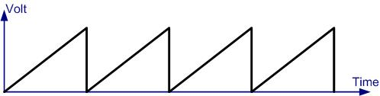
Saw Tooth Wave Form

Slide 35
Angle vs. Voltage Magnitude for Sine Wave
Angle Ɵ (degrees) | Sin Ɵ | V_{OUT} (Voltage Magnitude) 5V + (5V × sin Ɵ) | Values Sent to DAC (decimal) (Voltage Mag. × 25.6)
0 | 0 | 5 | 128
30 | 0.5 | 7.5 | 192
60 | 0.866 | 9.33 | 238
90 | 1.0 | 10 | 255
120 | 0.866 | 9.33 | 238
150 | 0.5 | 7.5 | 192
180 | 0 | 5 | 128
210 | -0.5 | 2.5 | 64
240 | -0.866 | 0.669 | 17
270 | -1.0 | 0 | 0
300 | -0.866 | 0.669 | 17
330 | -0.5 | 2.5 | 64
360 | 0 | 5 | 128

Slide 36
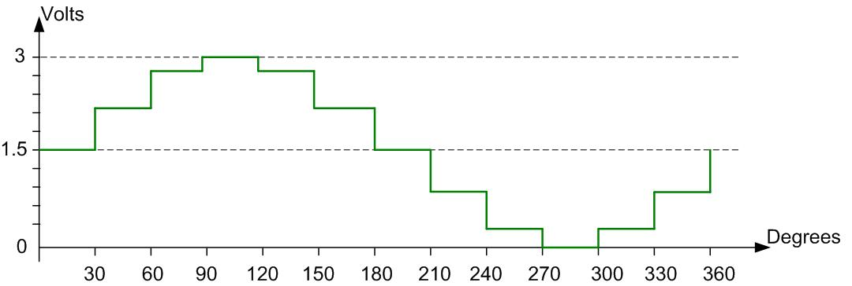
Angle vs. Voltage Magnitude for Sine Wave

