Slide 1
Chapter 5
MSP432 ARM Timer Programming

Slide 2
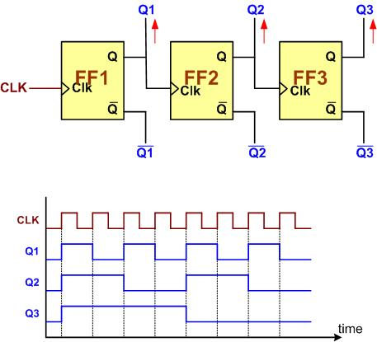
A 3-bit Counter

Slide 3

An 8-bit up-counter stages

Slide 4

An 8-bit down-counter stages

Slide 5

Counting Events Using a Counter

Slide 6
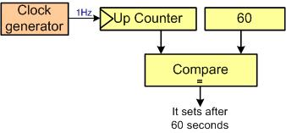
Using Counter as a Timer

Slide 7

Capturing

Slide 8
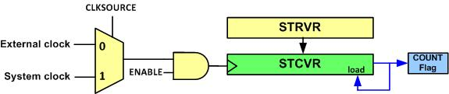
System Tick Timer Internal Structure

Slide 9
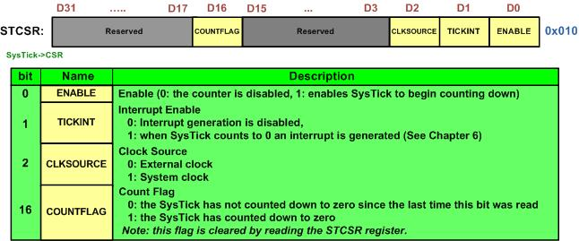
STCTRL (System Tick Control)

Slide 10
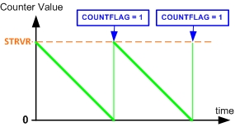
System Tick Counting

Slide 11
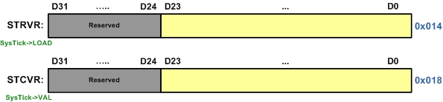
STRELOAD vs. STCURRENT

Slide 12
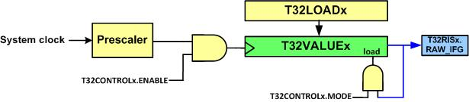
System Tick Timer Internal Structure

Slide 13
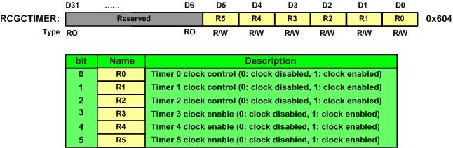
RCGCTimer (Timer Run Mode Clock Gating Control)

Slide 14
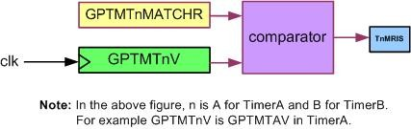
The Relation Between TnR, TnMATCHR, and TnMRIS

Slide 15
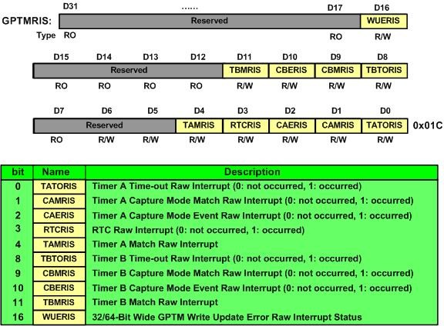
GPTMRIS

Slide 16

Timer Enable (TnEN)

Slide 17
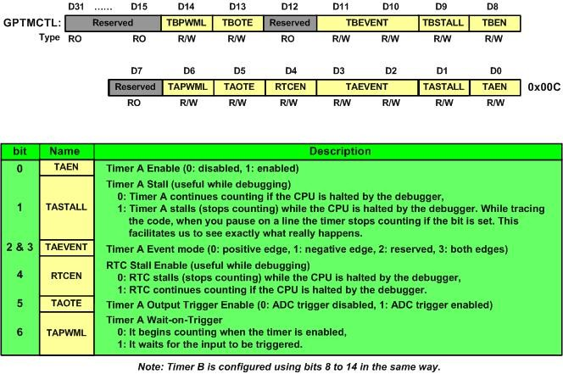
GPTM Control Register

Slide 18
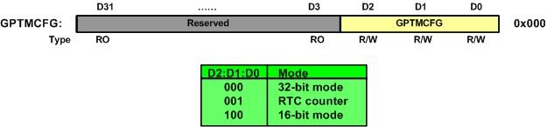
GPTM Configuration Register

Slide 19
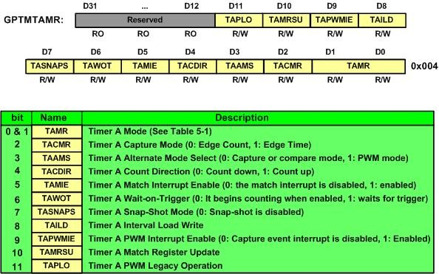
GPTMTAMR (GPTM Timer A Mode)

Slide 20
TAMR Bits of GPTMTAMR
Mode | D1 | D0 | Mode Name
0 | 0 | 0 | Reserved
1 | 0 | 1 | one-shot Mode
2 | 1 | 0 | Periodic Mode
3 | 1 | 1 | Capture Mode

Slide 21
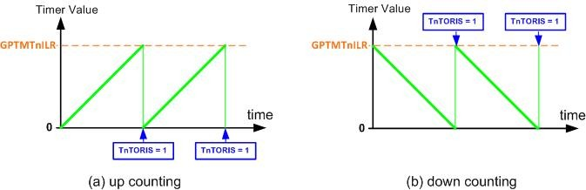
The role of GPTMTnR

Slide 22
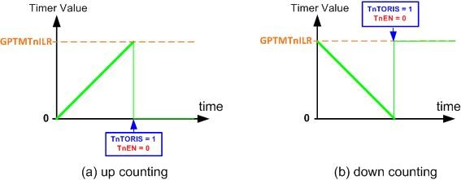
Counting in One Shot Mode

Slide 23
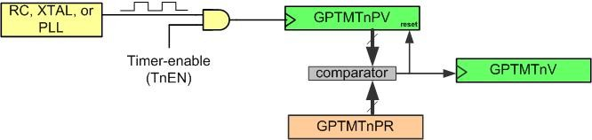
Prescaler

Slide 24
the pin designation for 16/32-bit Timer block 0 to 5
 | TimerA | Pins | TimerB | Pins
Timer0 | T0CCP0 | PB6 or PF0 | T0CCP1 | PB7 or PF1
Timer1 | T1CCP0 | PB4 or PF2 | T1CCP1 | PB5 or PF3
Timer2 | T2CCP0 | PB0 or PF4 | T2CCP1 | PB1
Timer3 | T3CCP0 | PB2 | T3CCP1 | PB3
Timer4 | T4CCP0 | PC0 | T4CCP1 | PC1
Timer5 | T5CCP0 | PC2 | T5CCP1 | PC3

Slide 25
Timers alternate pin assignment
Timer Pin | I/O pin | How to use peripheral function on the pin
T0CCP0 | PB6 | GPIOB->AFSEL =0x40 (0100 0000 binary)
 | PF0 | GPIOF->AFSEL =0x01 (0000 0001 binary)
T0CCP1 | PB7 | GPIOB->AFSEL =0x80 (1000 0000 binary)
 | PF1 | GPIOF->AFSEL =0x02 (0000 0010 binary)
T1CCP0 | PB4 | GPIOB->AFSEL =0x10 (0001 0000 binary)
 | PF2 | GPIOF->AFSEL =0x04 (0000 0100 binary)
T1CCP1 | PB5 | GPIOB->AFSEL =0x20 (0010 0000 binary)
 | PF3 | GPIOF->AFSEL =0x08 (0000 1000 binary)
T2CCP0 | PB0 | GPIOB->AFSEL =0x40 (0000 0001 binary)
 | PF4 | GPIOF->AFSEL =0x10 (0001 0000 binary)
T2CCP1 | PB1 | GPIOB->AFSEL =0x02 (0000 0010 binary)
T3CCP0 | PB2 | GPIOB->AFSEL =0x04 (0000 0100 binary)
T3CCP1 | PB3 | GPIOB->AFSEL =0x08 (0000 1000 binary)
T4CCP0 | PC0 | GPIOC->AFSEL =0x01 (0000 0001 binary)
T4CCP1 | PC1 | GPIOC->AFSEL =0x02 (0000 0010 binary)
T5CCP0 | PC2 | GPIOC->AFSEL =0x04 (0000 0100 binary)
T5CCP1 | PC3 | GPIOC->AFSEL =0x08 (0000 1000 binary)
WT0CCP0 | PC4 | GPIOC->AFSEL =0x10 (0001 0000 binary)
WT0CCP1 | PC5 | GPIOC->AFSEL =0x20 (0010 0000 binary)
WT1CCP0 | PC6 | GPIOC->AFSEL =0x40 (0100 0000 binary)
WT1CCP1 | PC7 | GPIOC->AFSEL =0x80 (1000 0000 binary)
WT2CCP0 | PD0 | GPIOD->AFSEL =0x01 (0000 0001 binary)
WT2CCP1 | PD1 | GPIOD->AFSEL =0x02 (0000 0010 binary)
WT3CCP0 | PD2 | GPIOD->AFSEL =0x04 (0000 0100 binary)
WT3CCP1 | PD3 | GPIOD->AFSEL =0x04 (0000 1000 binary)
WT4CCP0 | PD4 | GPIOD->AFSEL =0x10 (0001 0000 binary)
WT4CCP1 | PD5 | GPIOD->AFSEL =0x20 (0010 0000 binary)
WT5CCP0 | PD6 | GPIOD->AFSEL =0x40 (0100 0000 binary)
WT5CCP1 | PD7 | GPIOD->AFSEL =0x80 (1000 0000 binary)

Slide 26
Timers pin assignment using GPIO_PCTL (Extracted from Table 23-5 of Tiva data sheet)
Timer Pin | I/O Pin | How to select the timer function on the pin
T0CCP0 | PB6 | GPIOB->PCTL=0x0700 0000
 | PF0 | GPIOF->PCTL=0x0000 0007
T0CCP1 | PB7 | GPIOB->PCTL=0x7000 0000
 | PF1 | GPIOF->PCTL=0x0000 0070
T1CCP0 | PB4 | GPIOB->PCTL=0x0007 0000
 | PF2 | GPIOF->PCTL=0x0000 0700
T1CCP1 | PB5 | GPIOB->PCTL=0x0070 0000
 | PF3 | GPIOF->PCTL=0x0000 7000
T2CCP0 | PB0 | GPIOB->PCTL=0x0000 0007
 | PF4 | GPIOF->PCTL=0x0007 0000
T2CCP1 | PB1 | GPIOB->PCTL=0x0000 0070
T3CCP0 | PB2 | GPIOB->PCTL=0x0000 0700
T3CCP1 | PB3 | GPIOB->PCTL=0x0000 7000
T4CCP0 | PC0 | GPIOC->PCTL=0x0000 0007
T4CCP1 | PC1 | GPIOC->PCTL=0x0000 0070
T5CCP0 | PC2 | GPIOC->PCTL=0x0000 0700
T5CCP1 | PC3 | GPIOC->PCTL=0x0000 7000
WT0CCP0 | PC4 | GPIOC->PCTL=0x0007 0000
WT0CCP1 | PC5 | GPIOC->PCTL=0x0070 0000
WT1CCP0 | PC6 | GPIOC->PCTL=0x0700 0000
WT1CCP1 | PC7 | GPIOC->PCTL=0x7000 0000
WT2CCP0 | PD0 | GPIOD->PCTL=0x0000 0007
WT2CCP1 | PD1 | GPIOD->PCTL=0x0000 0070
WT3CCP0 | PD2 | GPIOD->PCTL=0x0000 0700
WT3CCP1 | PD3 | GPIOD->PCTL=0x0000 7000
WT4CCP0 | PD4 | GPIOD->PCTL=0x0007 0000
WT4CCP1 | PD5 | GPIOD->PCTL=0x0070 0000
WT5CCP0 | PD6 | GPIOD->PCTL=0x0700 0000
WT5CCP1 | PD7 | GPIOD->PCTL=0x7000 0000

Slide 27
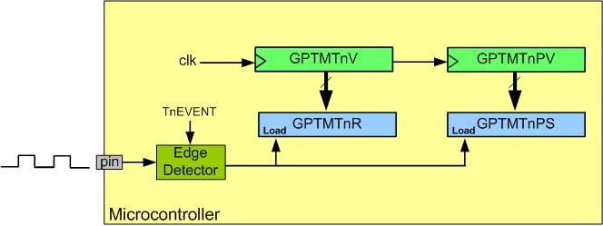
Input Edge Time Capturing

Slide 28
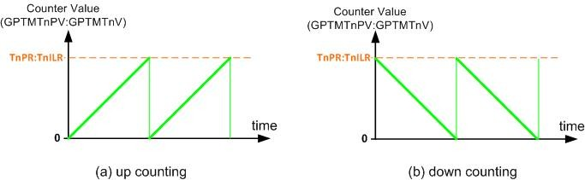
Counting in Input Edge-Time Mode

Slide 29
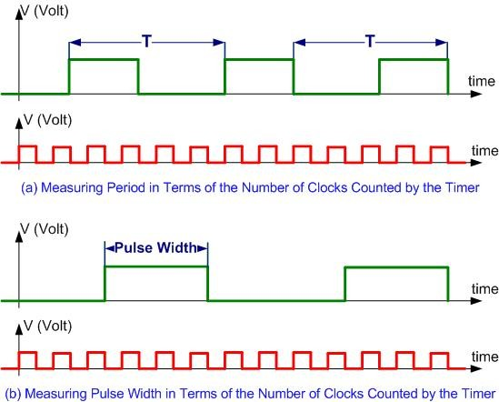
Measuring Period and Pulse Width

Slide 30
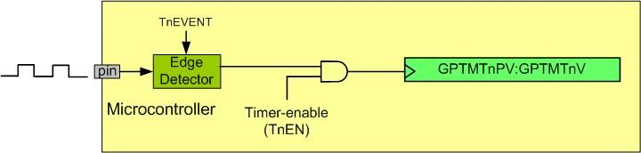
Counter Diagram

Slide 31
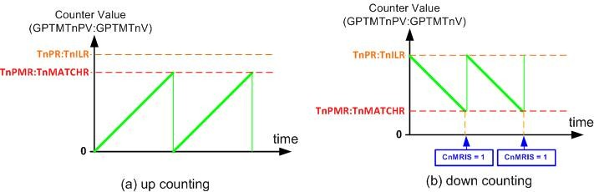
Counting in the Input Edge-Count Mode

