Slide 1
Chapter 4
UART Serial Port Programming

Slide 2
Serial vs. Parallel Data Transfer

Slide 3
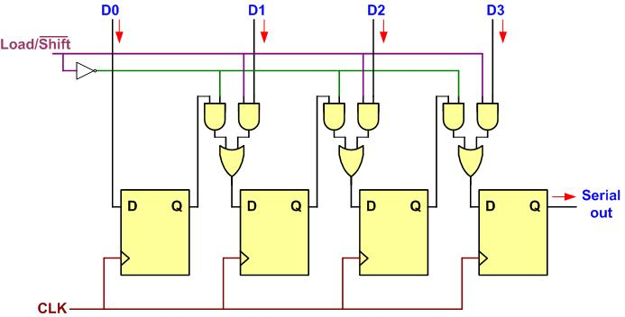
Parallel In Serial Out

Slide 4
Serial In Parallel Out

Slide 5
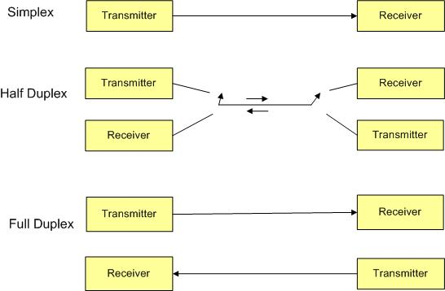
Simplex, Half-, and Full-Duplex Transfers

Slide 6
Framing ASCII "A" (0x41)

Slide 7
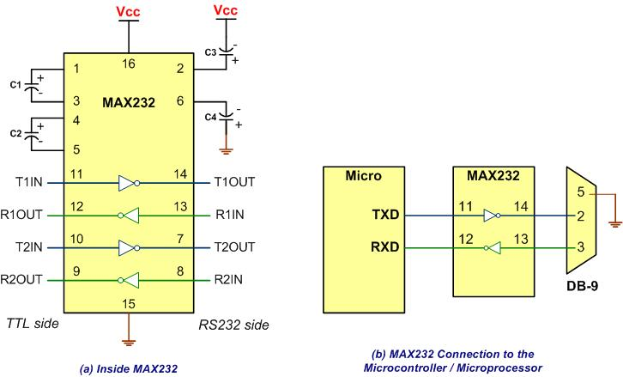
MAX232

Slide 8
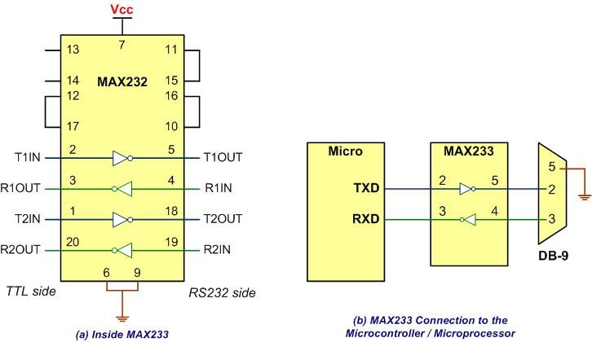
MAX233

Slide 9
RS232 Pins
Pin | Description
1 | Data carrier detect (DCD)
2 | Received data (RxD)
3 | Transmitted data (TxD)
4 | Data terminal ready (DTR)
5 | Signal ground (GND)
6 | Data set ready (DSR)
7 | Request to send (RTS)
8 | Clear to send (CTS)
9 | Ring indicator (RI)

Slide 10
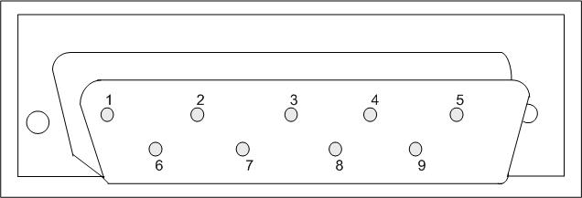
9-Pin Male Connector

Slide 11
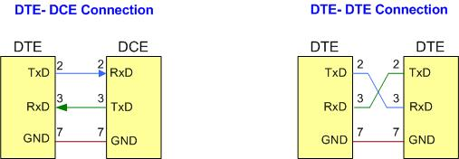
DTE-DCE and DTE-DTE Connections

Slide 12
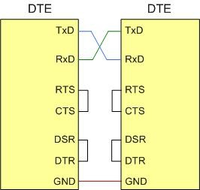
Null Modem Connection with Flow Control Signals

Slide 13
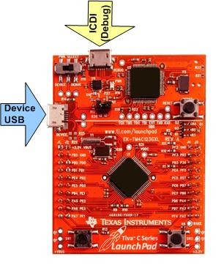
Tiva LaunchPad

Slide 14
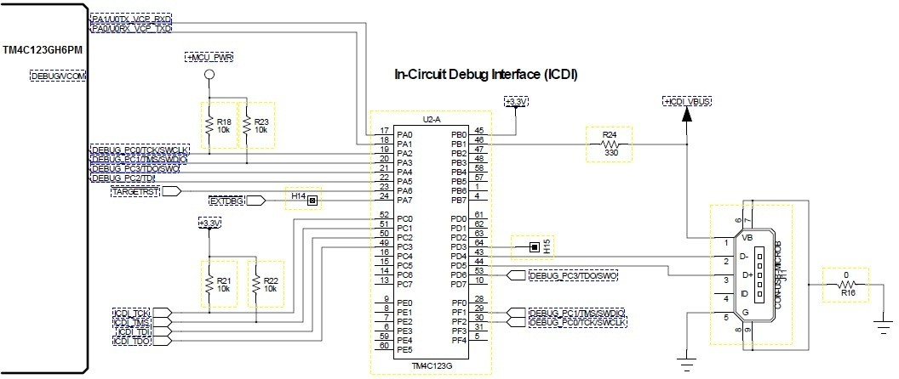
ICDI USB Port

Slide 15
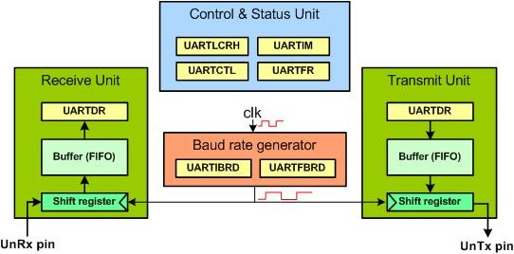
a Simplified Block Diagram of UARTn

Slide 16
UARTIBRD

Slide 17
UARTFBRD

Slide 18
UART Control (UARTCTL)

Slide 19
UART Line Control (UARTLCRH)

Slide 20
Partial list of UART0 Registers and their addresses
D6 | D5
0 | 0 | 5 bits
0 | 1 | 6 bits
1 | 0 | 7 bits
1 | 1 | 8 bits

Slide 21
UART Data (UARTDR)

Slide 22
UART Flag Register (UARTFR)

Slide 23
RCGCUART (UART Run Mode Clock Gating Control)

Slide 24
GPIOAMSEL (GPIO Analog Mode Select)

Slide 25
GPIO Alternate Function Select (GPIOAFSEL)

Slide 26
GPIOPCTL Register

Slide 27
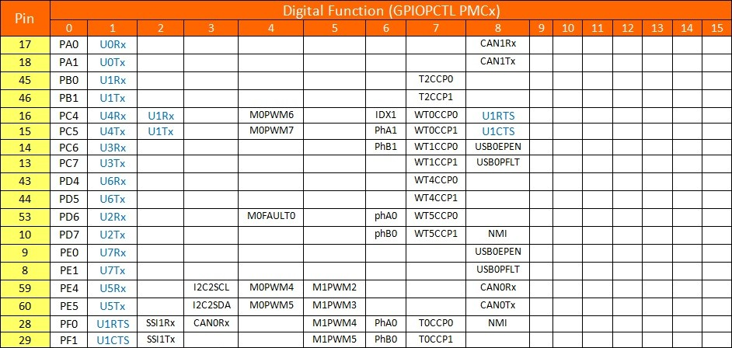
UART Pins and GPIOPCTL Registers

