Slide 1
Chapter 11
PWM and DC Motor Control

Slide 2
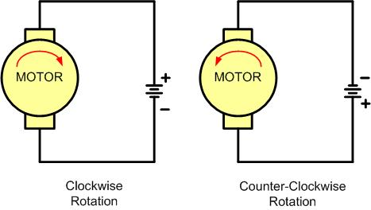
DC Motor Rotation (Permanent Magnet Field)

Slide 3
Selected DC Motor Characteristics
(http://www.Jameco.com)
Part No. | Nominal Volts | Volt Range | Current | RPM | Torque
154915CP | 3 V | 1.5–3 V | 0.070 A | 5,200 | 4.0 g-cm
154923CP | 3 V | 1.5–3 V | 0.240 A | 16,000 | 8.3 g-cm
177498CP | 4.5 V | 3–14 V | 0.150 A | 10,300 | 33.3 g-cm
181411CP | 5 V | 3–14 V | 0.470 A | 10,000 | 18.8 g-cm

Slide 4
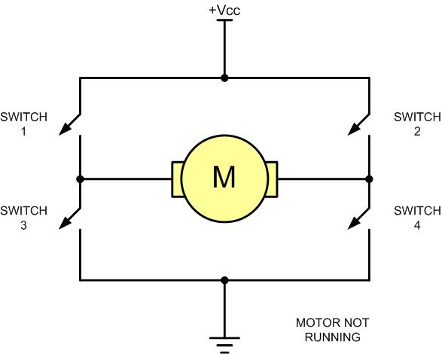
H-Bridge Motor Configuration

Slide 5
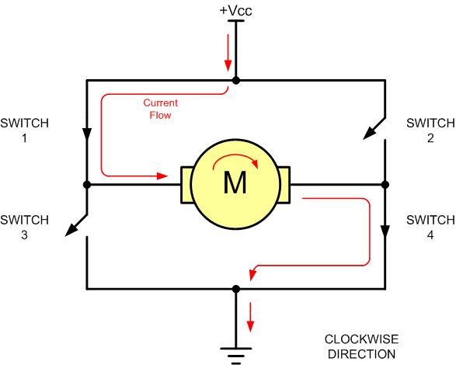
H-Bridge Motor Clockwise Configuration

Slide 6
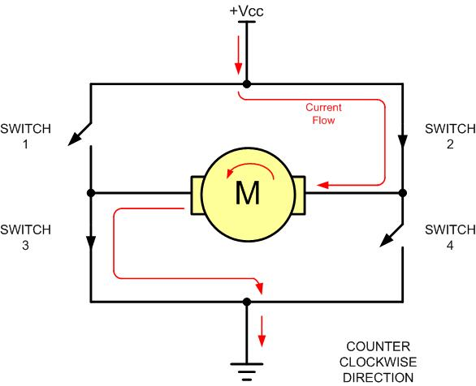
H-Bridge Motor Counterclockwise Configuration

Slide 7
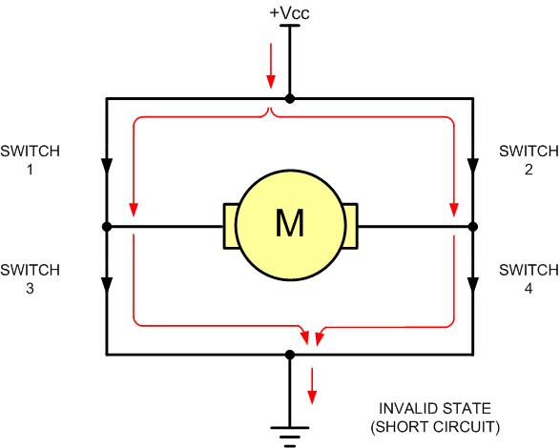
H-Bridge in an Invalid Configuration

Slide 8
Some H-Bridge Logic Configurations
Motor Operation | SW1 | SW2 | SW3 | SW4
Off | Open | Open | Open | Open
Clockwise | Closed | Open | Open | Closed
Counterclockwise | Open | Closed | Closed | Open
Invalid | Closed | Closed | Closed | Closed

Slide 9
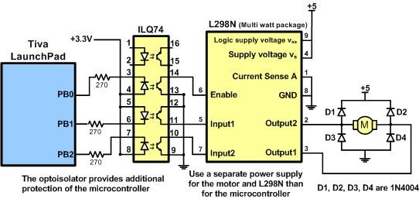
Bidirectional Motor Control Using an L298 Chip

Slide 10
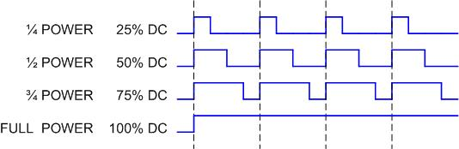
Pulse Width Modulation Comparison

Slide 11
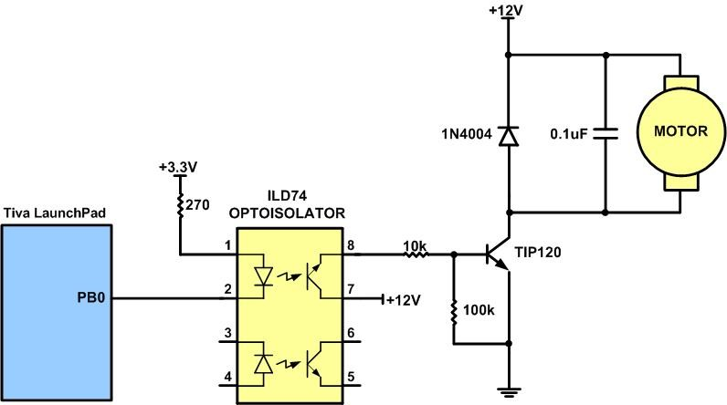
DC Motor Connection Using a Darlington Transistor

Slide 12
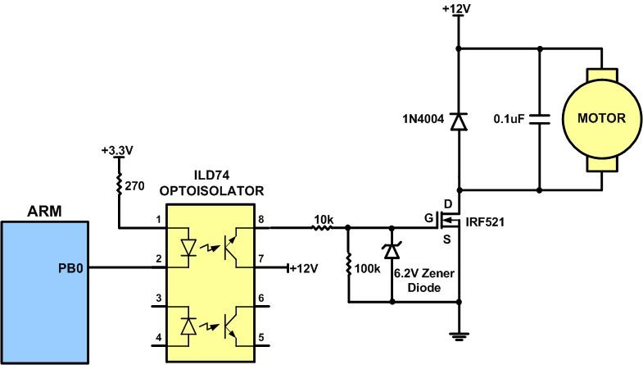
DC Motor Connection Using a MOSFET Transistor

Slide 13
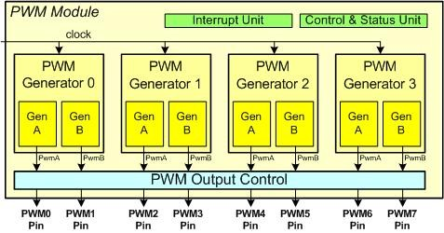
a PWM Module

Slide 14

RCGCPWM Register

Slide 15
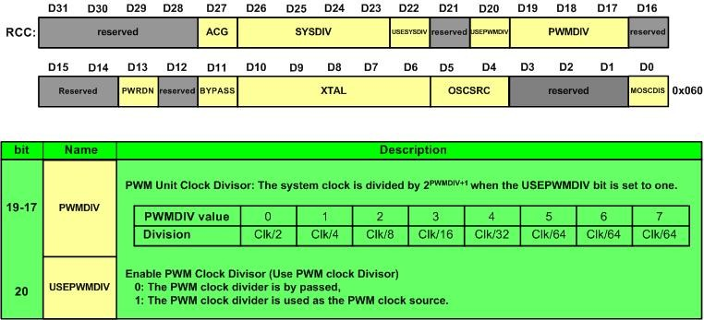
Run-Mode Clock Configuration (RCC), offset 0x060

Slide 16
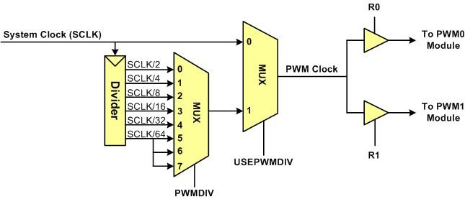
Clock Sources to PWM

Slide 17
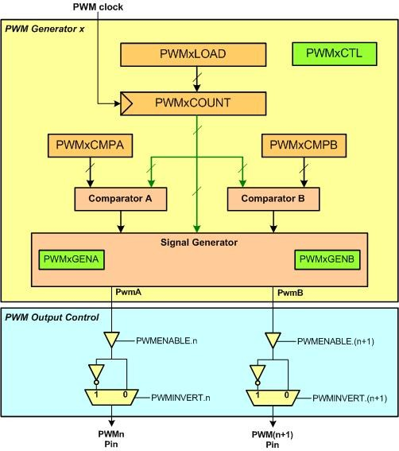
A PWM Generator (Counter) and PWMa and PWMb Output

Slide 18
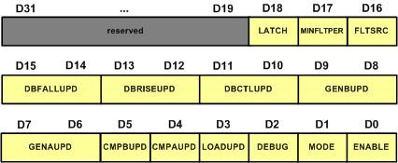
PWMxCTL Register

Slide 19
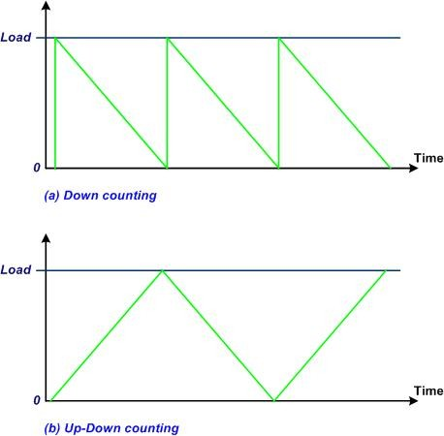
Up/down and down-counter

Slide 20
The Offset Addresses of PWMCTL Registers in TI TIVA
Register | Offset
PWM0_0_CTL (Control for Counter0) | 0x040
PWM0_1_CTL (Control for Counter1) | 0x080
PWM0_2_CTL (Control for Counter2) | 0x0C0
PWM0_3_CTL (Control for Counter3) | 0x100

Slide 21
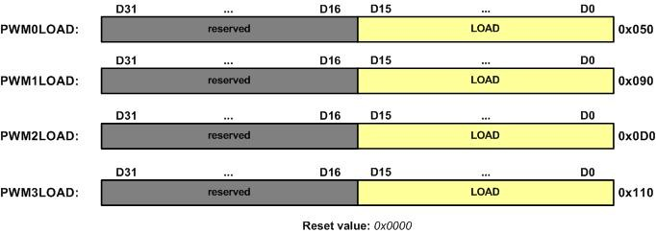
PWMxLOAD Register

Slide 22
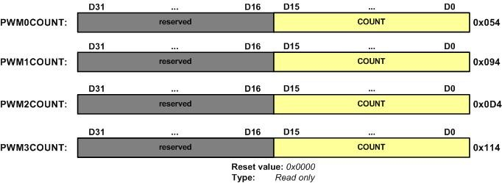
PWMxCOUNT (Current Counter)

Slide 23
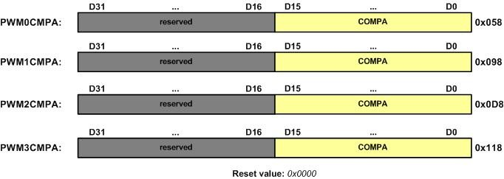
PWMxCMPA

Slide 24

PWMxCMPB

Slide 25
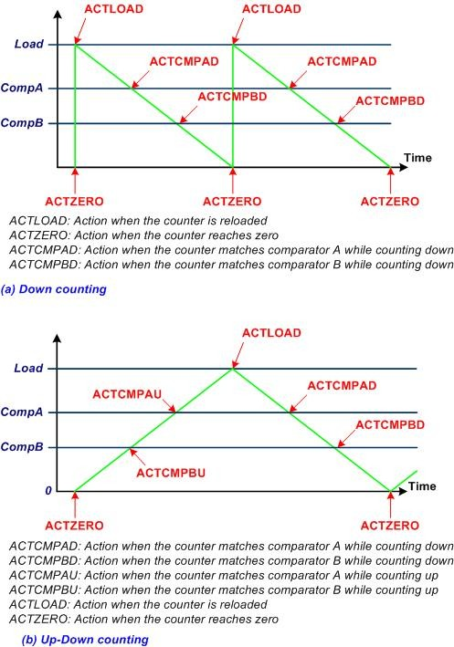
PWM Events in TI TIVA

Slide 26
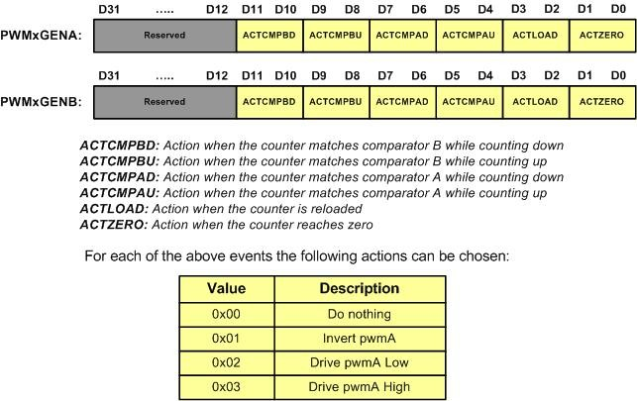
PWMxGENA and PWMxGENB registers

Slide 27
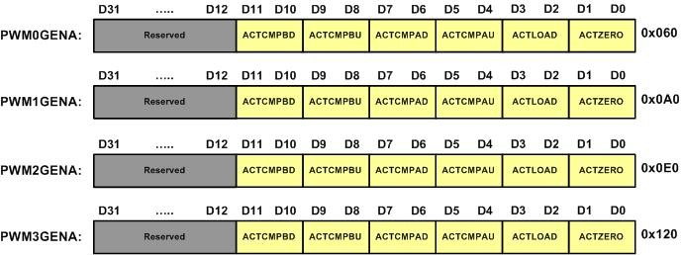
PWMxGENA

Slide 28

PWMxGENB

Slide 29
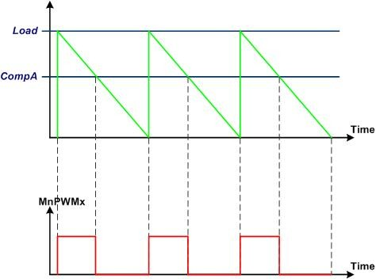
PWM generation using count-down mode and ComparatorA

Slide 30
a PWM Module (repeated)

Slide 31
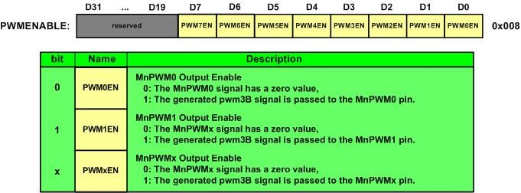
PWMENABLE

Slide 32
Module 0 (M0) PWM alternate pin assignment
M0PWMx | PIN | GPIOAFSL register
M0PWM0 | PB6 | GPIOB->AFSEL=0x40 (0100 0000 binary)
M0PWM1 | PB7 | GPIOB->AFSEL =0x80 (1000 0000 binary)
M0PWM2 | PB4 | GPIOB->AFSEL =0x10 (0001 0000 binary)
M0PWM3 | PB5 | GPIOB->AFSEL =0x20 (0010 0000 binary)
M0PWM4 | PE4 | GPIOE->AFSEL =0x10 (0001 0000 binary)
M0PWM5 | PE5 | GPIOE->AFSEL =0x20 (0010 0000 binary)
M0PWM6 | PC4 | GPIOC->AFSEL = 0x10 (0001 0000 binary)
 | PD0 | GPIOD->AFSEL = 0x01 (0000 0001 binary)
M0PWM7 | PC5 | GPIOC->AFSEL =0x0x20 (0010 0000 binary)
 | PD1 | GPIOD->AFSEL = 0x02 (0000 0010 binary)

Slide 33
Module 0 (M0) PWM pin assignment using GPIO_PCTL (Extracted from Table 23-5 of Tiva Manual)
M0PWMx | PIN | Value for GPIOPCTL register
M0PWM0 | PB6 | GPIO_PORTB_PCTL=0x0400000
M0PWM1 | PB7 | GPIO_PORTB_PCTL=0x4000000
M0PWM2 | PB4 | GPIO_PORTB_PCTL=0x0004000
M0PWM3 | PB5 | GPIO_PORTB_PCTL=0x00400000
M0PWM4 | PE4 | GPIO_PORTE_PCTL=0x0040000
M0PWM5 | PE5 | GPIO_PORTE_PCTL=0x00400000
M0PWM6 | PC4 | GPIO_PORTC_PCTL=00040000
 | PD0 | GPIO_PORTD_PCTL=0x00000004
M0PWM7 | PC5 | GPIO_PORTC_PCTL=0x00400000
 | PD1 | GPIO_PORTD_PCTL=0x00000040

Slide 34
Module 1 (M1) PWM Alternate pin assignment
M1PWMx | PIN | GPIO_AFSL register
M1PWM0 | PD0 | GPIOD->AFSEL =0x01 (0000 0001 binary)
M1PWM1 | PD1 | GPIOD->AFSEL =0x02 (0000 0010 binary)
M1PWM2 | PA6 or | GPIOA->AFSEL =0x40 (0100 0000 binary)
 | PE4 | GPIOE->AFSEL =0x10 (0001 0000 binary)
M1PWM3 | PA7 | GPIOA->AFSEL =0x80 (1000 0000 binary)
 | PE5 | GPIOE->AFSEL =0x20 (0010 0000 binary)
M1PWM4 | PF0 | GPIOF->AFSEL =0x01 (0000 0001 binary)
M1PWM5 | PF1 | GPIOF->AFSEL =0x02 (0000 0010 binary)
M1PWM6 | PF2 | GPIOF->AFSEL =0x04 (0000 0100 binary)
M1PWM7 | PF3 | GPIOF->AFSEL =0x08 (0000 1000 binary)

Slide 35
Module 1 (M1) PWM pin assignment using GPIO_PCTL register (Extracted from Table 23-5 of Tiva Manual)
M1PWMx | PIN | Value for GPIOPCTL
M1PWM0 | PD0 | GPIOD->PCTL= 0x00000005
M1PWM1 | PD1 | GPIOD->PCTL=0x00000050
M1PWM2 | PA6 | GPIOA->PCTL=0x05000000
 | PE4 | GPIOE->PCTL=0x00050000
M1PWM3 | PA7 | GPIOA->PCTL=0x50000000
 | PE5 | GPIOE->PCTL=0x00500000
M1PWM4 | PF0 | GPIOF->PCTL=0x00000005
M1PWM5 | PF1 | GPIOF->PCTL=0x00000050
M1PWM6 | PF2 | GPIOF->PCTL=0x00000500
M1PWM7 | PF3 | GPIOF->PCTL=0x00005000

