Slide 1
Chapter 4
UART Serial Port Programming

Slide 2
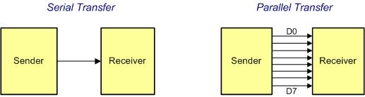
Serial vs. Parallel Data Transfer

Slide 3
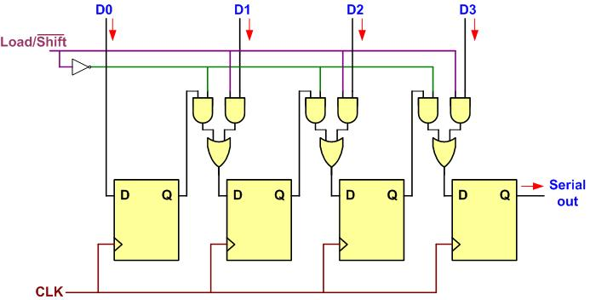
Parallel In Serial Out

Slide 4
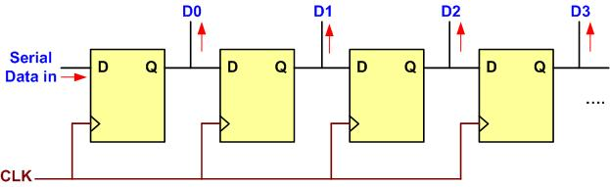
Serial In Parallel Out

Slide 5
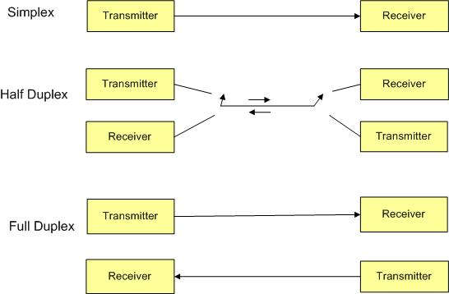
Simplex, Half-, and Full-Duplex Transfers

Slide 6
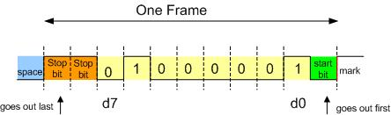
Framing ASCII "A" (0x41)

Slide 7
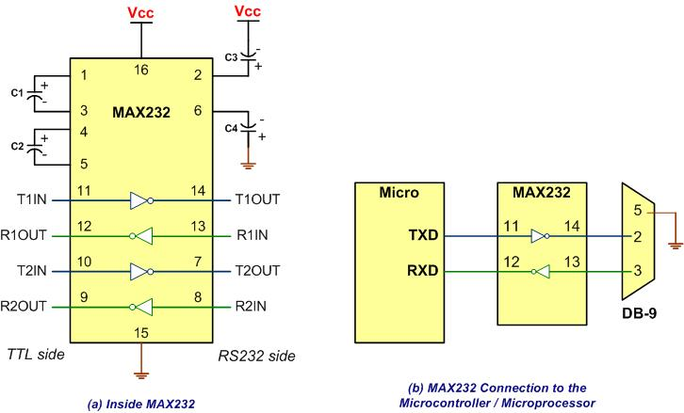
MAX232

Slide 8
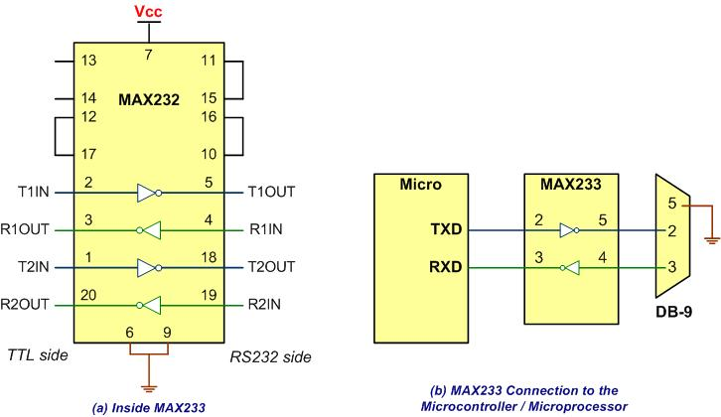
MAX233

Slide 9
RS232 Pins
Pin | Description
1 | Data carrier detect (DCD)
2 | Received data (RxD)
3 | Transmitted data (TxD)
4 | Data terminal ready (DTR)
5 | Signal ground (GND)
6 | Data set ready (DSR)
7 | Request to send (RTS)
8 | Clear to send (CTS)
9 | Ring indicator (RI)

Slide 10
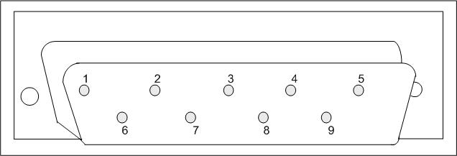
9-Pin Male Connector

Slide 11
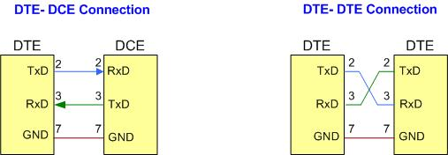
DTE-DCE and DTE-DTE Connections

Slide 12
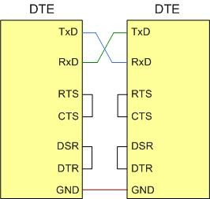
Null Modem Connection with Flow Control Signals

Slide 13
ST-Link-V2-1 in Nucleo ST Arm board

Slide 14
ST-Link-V2-1 in Nucleo ST Arm board

Slide 15
St-Link/V2 USART2-USB Port Connection

Slide 16
Partial list of USART Registers and their addresses

Slide 17
A Simplified Block Diagram of USART

Slide 18
RCC_CR (RCC Control Register) to showing the HSI Clock Source

Slide 19
RCC_CFGR (Clock Configuration Register) Clock Select Resgister bit assignment

Slide 20
Clock Generation for USART2

Slide 21
APB1ENR peripheral clock enable register (RCC_APB1ENR) Bit Assignments (Partial Listing)

Slide 22
BAUD (USART_BRR) Register

Slide 23
BAUD Rate Register (BRR) Values for Some Baud Rates using OVER=16 and clock of 16MHz.

Slide 24
BAUD Rate Register (BRR) Values for Some Baud Rates using OVER=8 and clock of 16MHz.

Slide 25
USART CR1 (Control 1 Register) bits definition (Partial Listing)

Slide 26
USART Control 2 (USART_CTR2) register (Partial Listing)

Slide 27
USART_DR, USART Data Register

Slide 28
Status Register (USART_SR)

Slide 29
GPIO_AFRL (GPIO Alternate Function Register Low)

Slide 30
GPIO_AFRH (GPIO Alternate Function Register High)

Slide 31
partial list of STM Arm Pins Used for USART (See Appendix B and Table 4-6)

Slide 32
GPIOx_MODER (GPIO Mode) for Direction Register (x=A, B, C,..)

Slide 33
Alternate Functions (AF) Pin Multiplexing for Port A in STM32F446 Arm. See Appendix B for other Ports. (See AF table for your device)

