Slide 1
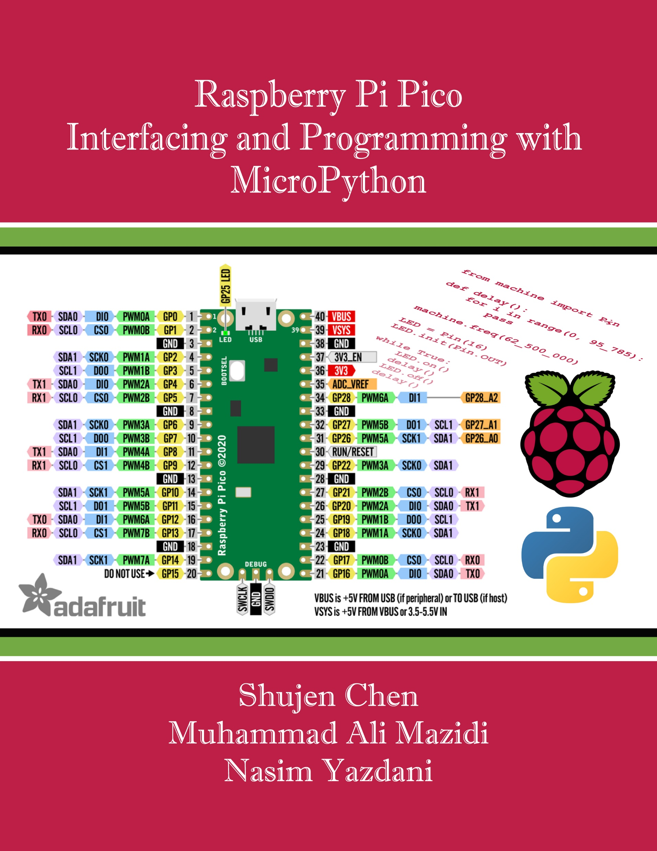
Chapter 5:
Timer Programming in Pico
Raspberry Pi Pico
Interfacing and Programming
with MicroPython
www.NicerLand.com
www.MicroDigitalEd.com

Slide 2
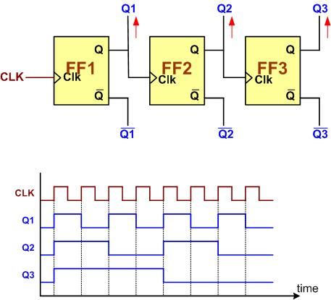
Figure 5-1: A 3-bit Counter

Slide 3
Figure 5-2: an 8-bit Up-Counter Stages
Figure 5-3: an 8-bit Down-Counter Stages

Slide 4
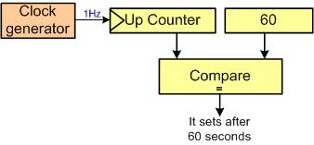
Figure 5-4: Counting Events Using a Counter
Figure 5-5: Using Counter as a Timer

Slide 5
Figure 5-6: Capturing

